Slide 1
CE 395R - Data Mining Data Mining with WEKA (Classification – Decision Trees)

Slide 2
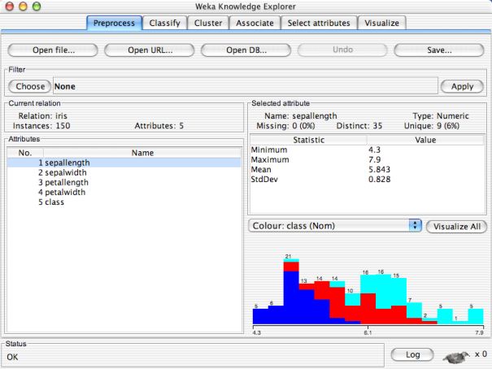


Slide 3
WEKA Explorer: building “classifiers”
Classifiers in WEKA are models for classifying nominal or numeric data
Implemented learning schemes include:
Decision trees, naïve Bayes, instance-based classifiers, support vector machines, multi-layer neural networks, logistic regression, Bayes’ nets, …
“Meta”-classifiers include:
Bagging, boosting, stacking, error-correcting output codes, locally weighted learning, …

Slide 4
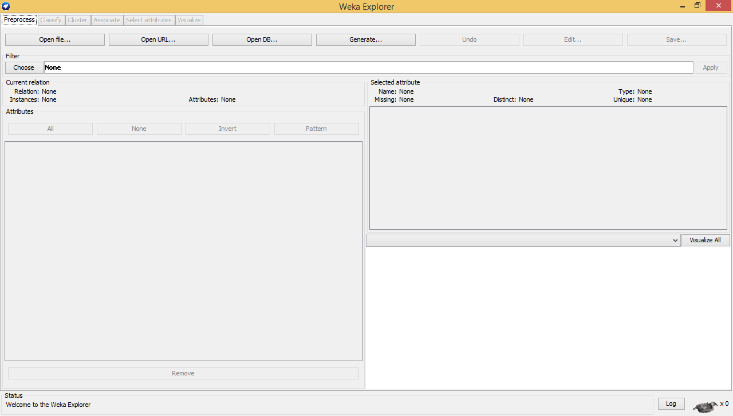

Slide 6
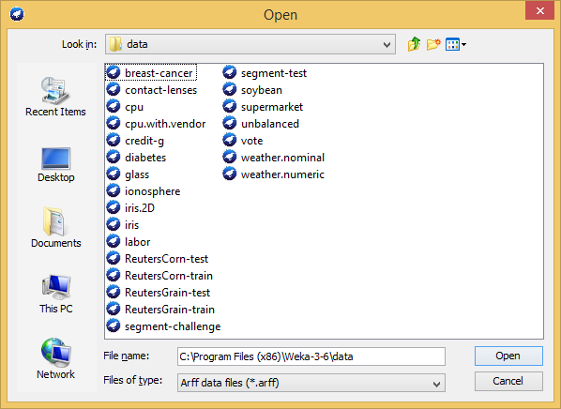

Slide 7
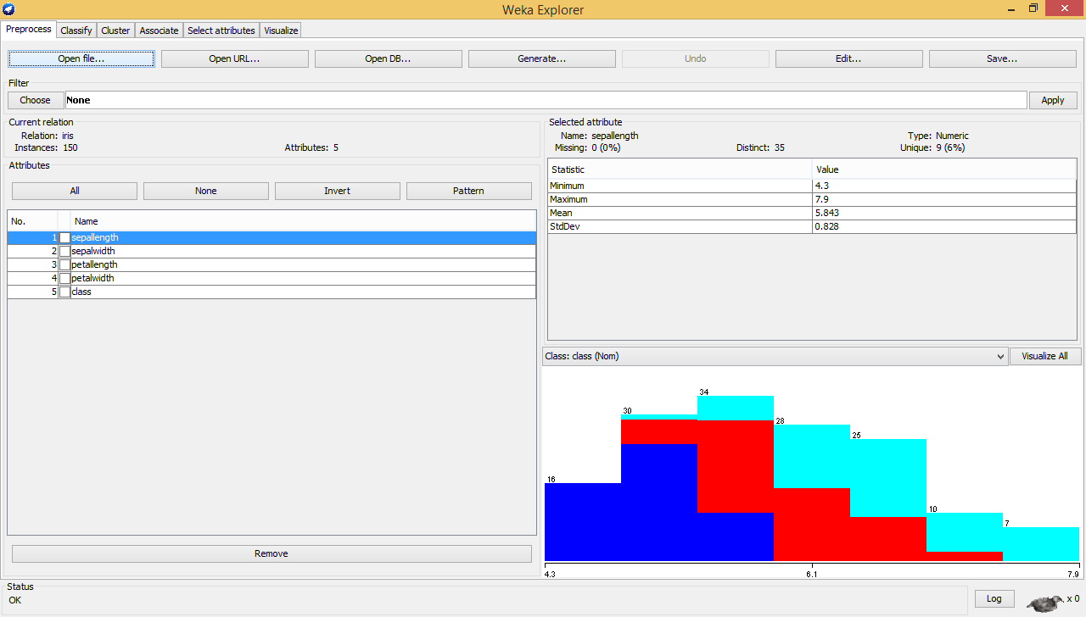

Slide 9
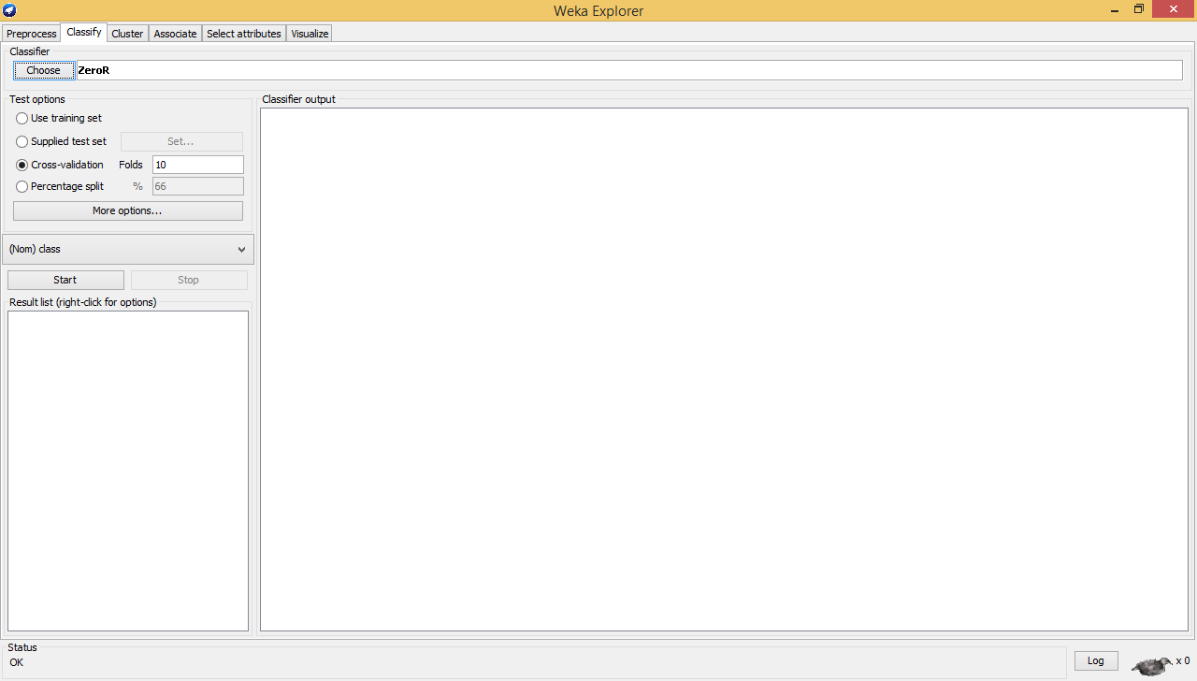

Slide 11
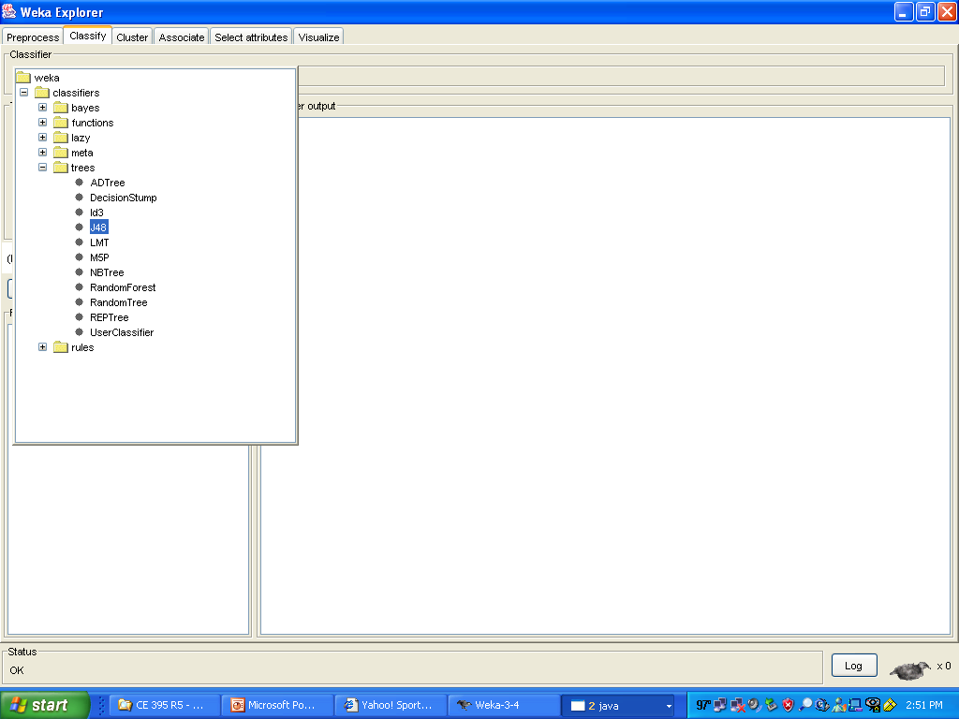

Slide 12

right-click

Slide 13
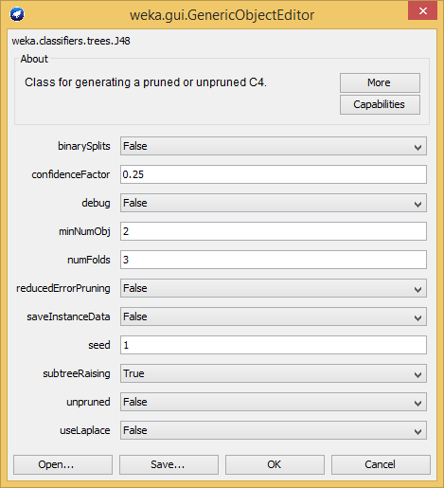

Slide 14
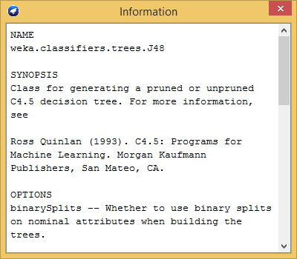

Slide 16


Slide 18
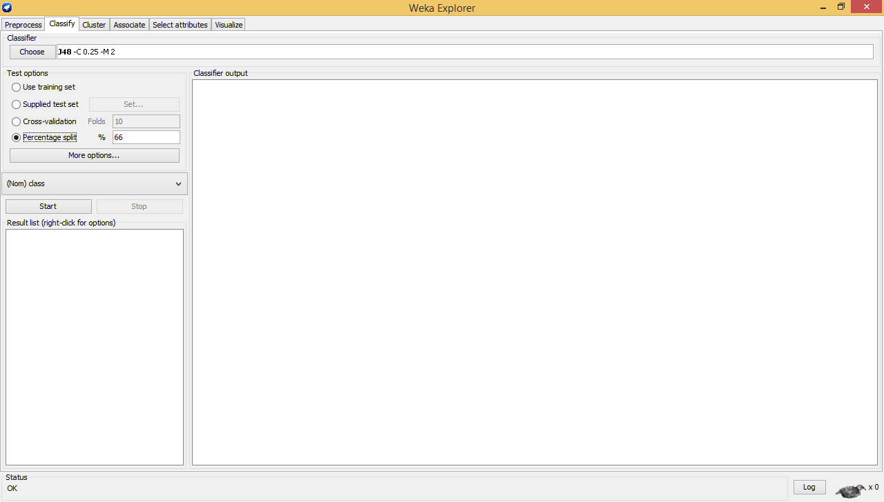

Slide 19
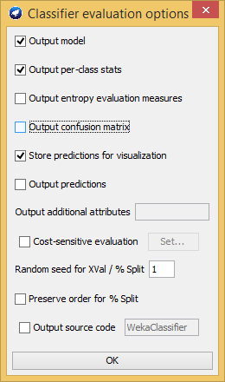

Slide 22
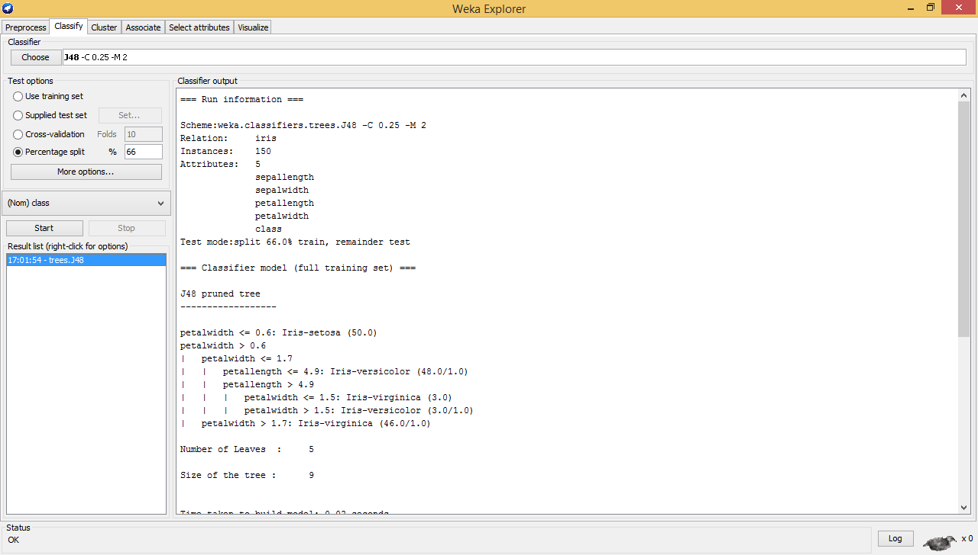

Slide 24
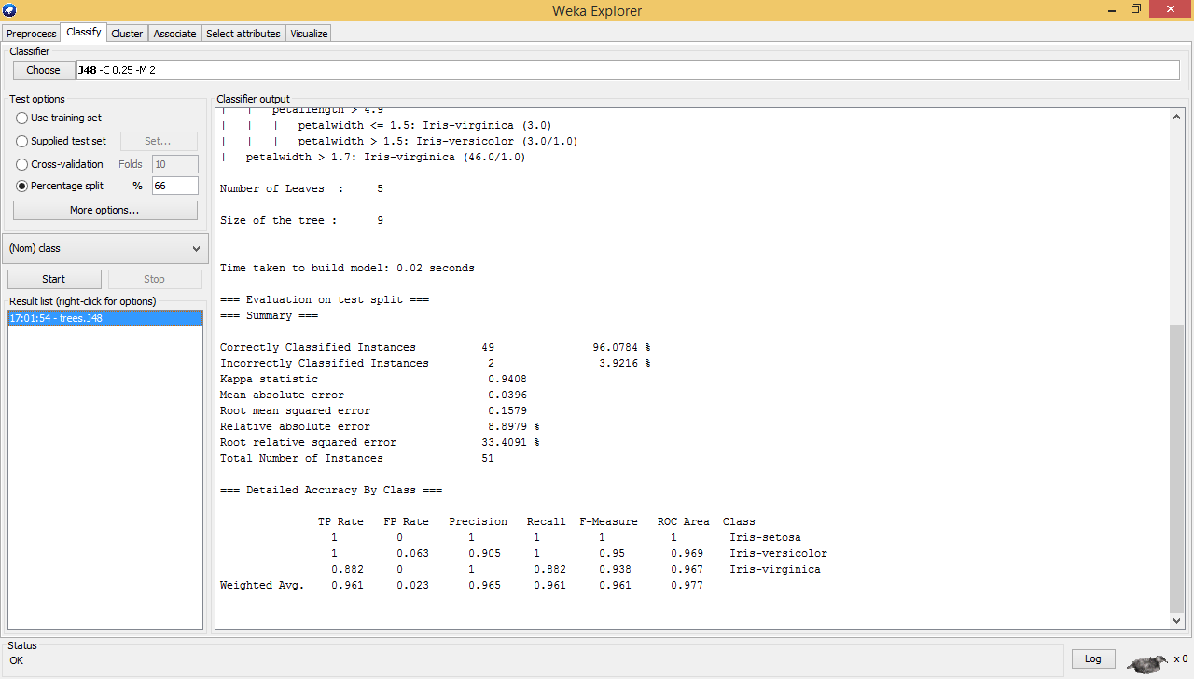

Slide 25
right-click

Slide 26
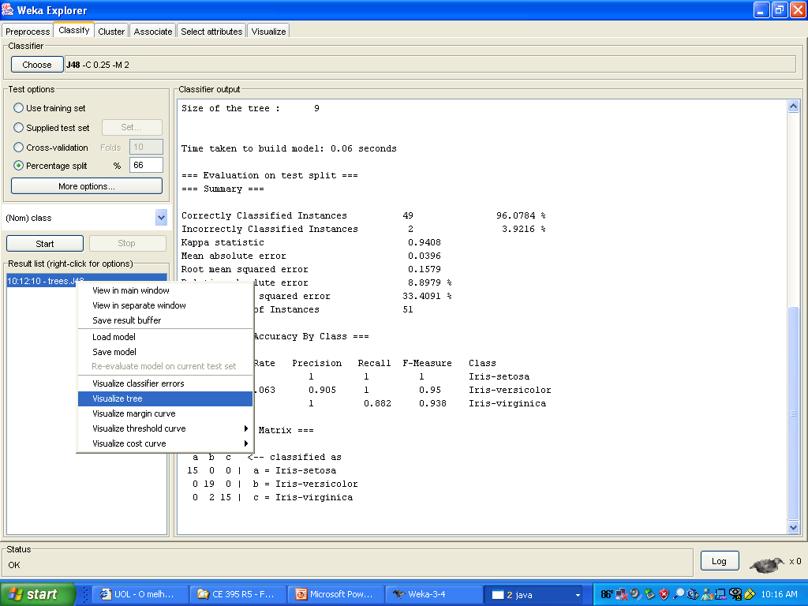

Slide 27
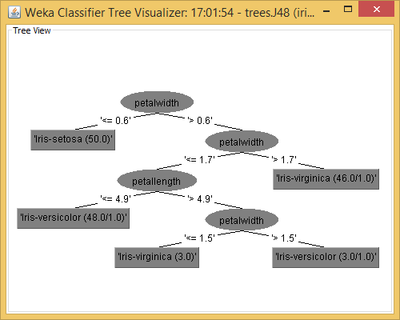

Slide 28
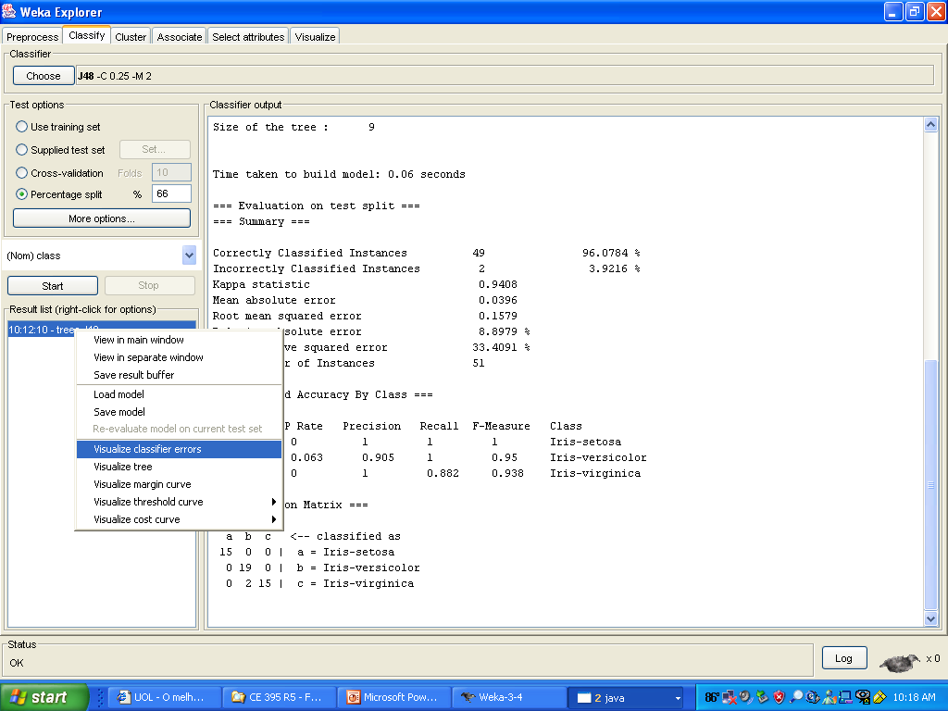

Slide 29
